Slide 1
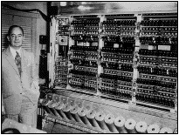
S03: Instruction Set Architecture
Required: PM: Ch 7.1-3, pgs 81-95 MSP430 Disassembly.html Code: Chs 18-19, pgs 238-285
Recommended: Introduction to TI MSP430 Launchpad Tutorial MSP430 User's Guide (3.0-3)

Slide 2
CS 224
Chapter | Lab | Homework
S00: Introduction
Unit 1: Digital Logic
S01: Data Types S02: Digital Logic | L01: Warm-up L02: FSM | HW01 HW02
Unit 2: ISA
S03: ISA S04: Microarchitecture S05: Stacks / Interrupts S06: Assembly | L03: Blinky L04: Microarch L05b: Traffic Light L06a: Morse Code | HW03 HW04 HW05 HW06
Unit 3: C
S07: C Language S08: Pointers S09: Structs S10: I/O | L07b: Morse II L08a: Life L09b: Snake | HW07 HW08 HW09 HW10

Slide 3
Learning Outcomes…
After discussing Instruction Set Architecture and studying the reading assignments, you should be able to:
Explain what is a computer architecture.
Describe the differences between a Harvard and von Neumann machine.
Describe the differences between a RISC and CISC machine.
Explain the addressing modes of the MSP430.
Discuss computer instruction cycles.
Disassemble MSP430 instructions.

Slide 4
Topics to Cover…
ISA
Von Neumann vs. Harvard
RISC vs.CISC
Computer Instructions
MSP430 ISA
MSP430 Registers
MSP430 ALU
Assembler Primer
MSP430 Instructions
Double Operand
Single Operand
Jump
Addressing Modes
Instruction Length
Clock Cycles
Instruction Disassembly

Slide 5
Instruction Set Architecture
ISA
The computer ISA defines all the programmer-visible components and operations of the computer
Memory organization
address space -- how may locations can be addressed?
addressibility -- how many bits per location?
Register set
how many? what size? how are they used?
Instruction set
opcodes
data types
addressing modes
ISA provides all information needed for someone that wants to write a program in machine language (or translate from a high-level language to machine language).

Slide 6
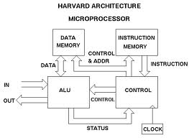
Harvard Architecture
Von Neumann vs. Harvard
The Harvard architecture is a computer architecture with physically separate storage and signal pathways for instructions and data.
DATA
MEMORY
INSTRUCTION
MEMORY
Control & Address
Data
Instruction
IN
ALU
Control
CONTROL
Examples:
8051
Atmel AVR
ARM
OUT
Status
CLOCK

Slide 7
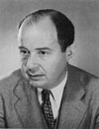
The Von Neumann Computer
Von Neumann vs. Harvard
MEMORY
INPUT
* keyboard
* mouse
* scanner
* A/D
* serial
* disk
OUTPUT
* monitor
* printer
* LEDs
* D/A
* disk
Address Bus
Data Bus
PROCESSING UNIT
Von Neumann proposed this model in 1946
ALU
Registers
Clock
Datapath
Program Counter
Control
Logic
Control
Instruction Register
Examples:
Cray
PC’s
MSP430
The Von Neumann model: Program instructions and Data are both stored as sequences of bits in computer memory
Notes:
John von Neumann ( /vɒn ˈnɔɪmən/; December 28, 1903 – February 8, 1957) was a Hungarian-American mathematician and polymath who made major contributions to a vast number of fields,^{[1]} including mathematics (set theory, functional analysis, ergodic theory, geometry, numerical analysis, and many other mathematical fields), physics (quantum mechanics, hydrodynamics, and fluid dynamics), economics (game theory), computer science (linear programming), and statistics. He is generally regarded as one of the greatest mathematicians in modern history.^{[2]}
As a 6 year old, he could divide two 8-digit numbers in his head.^{[14]} By the age of 8, he was familiar with differential and integral calculus.[

Slide 8
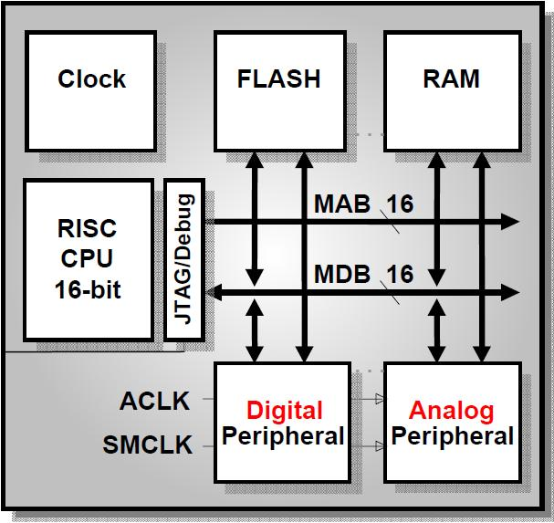
MSP430 Architecture
Von Neumann
Instructions
and Data
Processing
Unit (CPU)
Input / Output

Slide 9
RISC / CISC Architecture
RISC vs. CISC
RISC
CISC
Single-clock
Reduced instructions
No microcode
Data explicitly accessed
Easier to validate
Larger code sizes (~30%)
Low cycles/second
More transistors on memory registers
Pipelining friendly
Emphasis on software
Multi-clock
Complex instructions
Complicated microcode
Memory to memory operations
Difficult to validate
Smaller code sizes
High cycles/second
More transistors for complex instructions
Compiler friendly
Emphasis on hardware

Slide 10
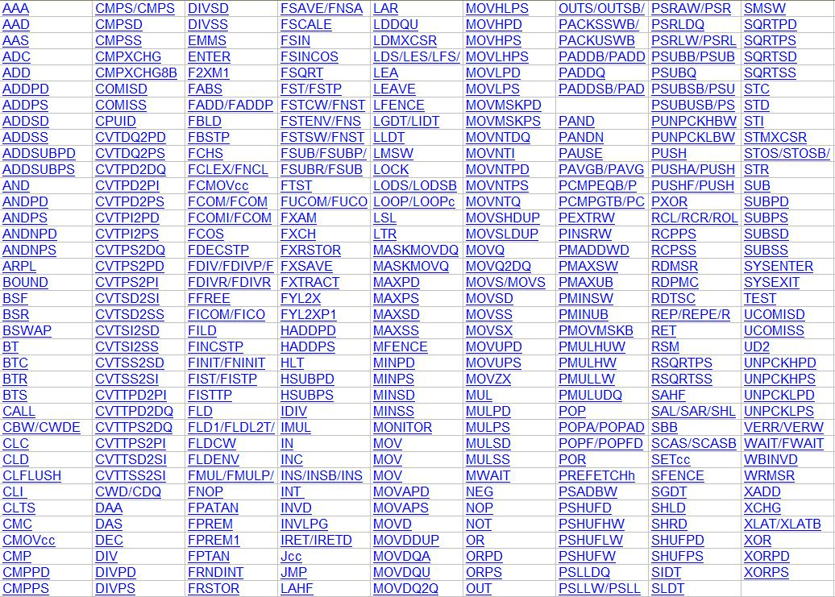
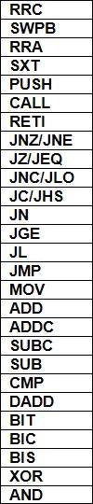
RISC/CISC Instruction Set
RISC vs. CISC
MSP430
(RISC)
IA-32 (CISC)
Special
Jump
Arithmetic
Logical
27 Instructions

Slide 11
Quiz 3.1
What best differentiates RISC and CISC architectures?
CISC
RISC
□ □ Compiler friendly
□ □ Larger code sizes (~30%)
□ □ Complicated microcode
□ □ Fewer instructions
□ □ Easier to validate
□ □ Emphasis on hardware
□ □ Emphasis on software
□ □ Memory to memory operations
□ □ Pipelining friendly

Slide 12
Computer Instructions

Slide 13
Computer Instructions
Computer Instructions
Computer program consists of a sequence of instructions
instruction = verb + operand(s)
stored in memory as 1’s and 0’s
called machine code.
Instructions are fetched from memory
The program counter (PC) holds the memory address of the next instruction (or operand).
The instruction is stored internal to the CPU in the instruction register (IR).
Programs execute sequentially through memory
Execution order is altered by changing the Program Counter.
A computer clock controls the speed and phases of instruction execution.

Slide 14
Machine vs Assembly Code
Computer Instructions
Machine Code
Assembly Code
0100000000110001
mov.w #0x0600,r1
0000011000000000
0100000010110010
mov.w #0x5a1e,&0x0120
0101101000011110
Assembler
0000000100100000
0100001100001110
mov.w #0,r14
0101001101011110
add.b #1,r14
1111000001111110
and.b #0x0f,r14
0000000000001111
0001001000110000
Disassembler
push #0x000e
0000000000001110
1000001110010001
sub.w #1,0(r1)
0000000000000000
0010001111111101
jne $-4
0100000100111111
mov.w @r1+,r15

Slide 15
Anatomy of Machine Instruction
Computer Instructions
“Add the value in Register 4 to the value in Register 5”
add r4,r5
0101010000000101
How many
source/destination
registers can
selected with a
4-bit field?
1. Verb – Opcode (0, 1, or 2 operands)
2. 1st object – Source Operand
How many
instructions are
possible with a
4-bit op-code?
3. 2nd object – Destination Operand

Slide 16
Instruction Addressing Modes
Computer Instructions
Machine language instructions operate (verb) on operands (objects).
Addressing modes define how the computer identifies the operand (or operands) of each instruction.
Operands are found in
registers,
instructions, or
memory.
Memory operands are accessed
directly,
indirectly (pointer), or
indexed.

Slide 17
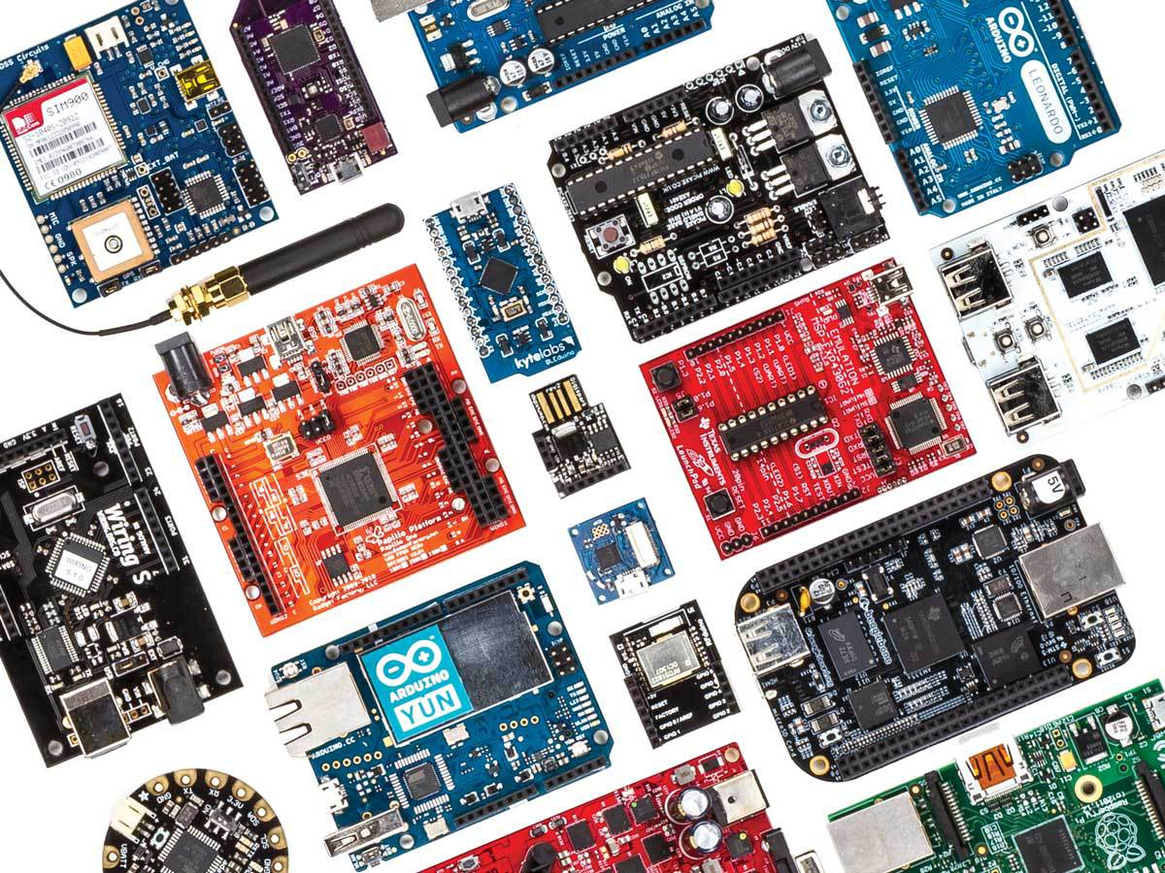
Today’s Microcontrollers…
Intel 4004 | TinyDuino
Z80 | DigiSpark
6502 | Arduino Yun
Microchip PIC | BLEduino
Parallax BASIC STAMP | Geogram One
Arduino | Raspberry PI
Tessel | BeagleBone
LaunchPad MSP430 | PCDuino
Picaxe-28X2 Shields | AMD Gizmo Board
Netduino | Lilypad
Parallax Propeller | Papilio One FPGA

Slide 18
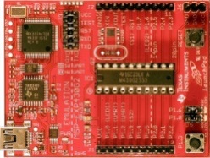
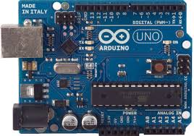
LaunchPad vs Arduino
TI MSP430
Von Neumann
16-bit RISC/CISC
27 Instructions
16 16-bit orthogonal Registers
16-bit ALU
Up to 24 MHz
1.2 - 3.3 volt
Active Mode:
Power-down:
Atmega8/168
Harvard architecture
8-bit RISC
131 Instructions
32 8-bit address/data Registers
8-bit ALU
1 - 20 MHz (↑20 MIPS)
5 volt
Active Mode: 0.2 mA
Power-down Mode: 0.1 μA

Slide 19
MSP430 ISA

Slide 20
MSP430 ISA
MSP430 ISA
RISC/CISC machine
27 orthogonal instructions
8 jump instructions
7 single operand instructions
12 double operand instructions
4 basic addressing modes.
8/16-bit instruction addressing formats.
Memory architecture
16 16-bit registers
16-bit Arithmetic Logic Unit (ALU).
16-bit address bus (64K address space)
16-bit data bus (8-bit addressability)
8/16-bit peripherals

Slide 21
MSP430 Bus Architecture
MSP430 ISA
Memory Address Bus (uni-directional)
Address Space = number of possible
memory locations (memory size)
Memory Address Register (MAR) stores
the memory address for the address bus
Addresses peripherals as well as memory.
Memory Data Bus (bi-directional)
Addressability = # of bits stored in each memory location (8-bits).
Memory Select (MSEL) connects an addressed memory location to the data bus.
Memory Write Enable (MWE) is asserted when writing to memory.
CPU addresses data values either as bytes (8 bits) or words (16 bits). Words are always addressed at an even address (least significant byte), followed by the next odd address (significant byte) which is little endian.

Slide 22
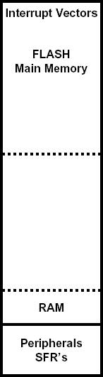
MSP430 Memory Architecture
MSP430 ISA
0xFFFF
Memory
64k byte addressable, address space
(0x0000 - 0xFFFF)
Flash / ROM – Used for both code/data
Interrupt vectors - Upper 16 words
RAM (0x200 - 0x9FF) – Volatile storage
Peripherals
16-bit peripherals (0x0100 - 0x01FF)
8-bit peripherals (0x0010 - 0x00FF)
Special Function Registers – Lower 16 bytes
Flash (ROM)
RAM
Input / Output
Used to get information in and out of the computer.
External devices attached to a computer are called peripherals.
Lower 512 bytes (0x0000 - 0x01FF) of address space
I/O
0x0000

Slide 23
MSP430 ALU Architecture
MSP430 ISA
ALU (Arithmetic and Logic Unit)
performs the arithmetic and logical
operations
Arithmetic operations: add, subtract
Logical operations: and, xor, bit
Sets condition codes
The word length of a computer is the
number of bits processed by the ALU.
Sixteen 16-bit registers
Program Counter (R0), Stack Pointer (R1), Status Register (R2)
Constant Generator (R3), General Purpose Registers (R4-R15)
Very fast memory - close to the ALU (register file).

Slide 24
MSP430 ALU
MSP430 ALU
16 bit Arithmetic Logic Unit (ALU).
Performs instruction arithmetic and logical operations.
Instruction execution may affect the state of the following status bits:
Zero (Z)
Carry (C)
Overflow (V)
Negative (N)
The MCLK (Master) clock signal drives the CPU and ALU logic.

Slide 25
MSP430 Registers
MSP430 Registers
Register | Name | Function
R0 (PC) | Program Counter | Address of next instruction to be fetched. LSB is always zero. Incremented by 2, 4, or 6
R1 (SP) | Stack Pointer | Return address of calls and interrupts Programs local data “Grows down” thru RAM LSB is always zero.
R2 (SR/CG1) | Status Register | Carry, negative, zero, overflow status bits Interrupt enable Power mode Constant generator for 4, 8 (CG1)
R3 (CG2) | Constant Generator | Constant generator for -1, 0, 1, 2
R4-R15 | General Purpose

Slide 26
MSP430 Control Architecture
MSP430 ISA
Clock
System and peripheral clocks
Control Unit
The control unit directs the execution of
the program
The Program Counter (R0) or PC points to the next instruction to be executed
The Instruction Register or IR contains
the current executing instruction
The Status Register (R2) or SR contains
information about the last instruction
executed as well as system parameters
The control unit prevents bus conflicts and timing/propagation problems
The control unit is a Finite State Machine driven by a clock

Slide 27
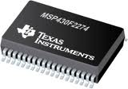
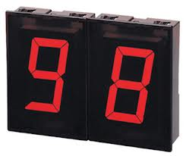
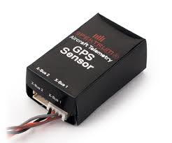
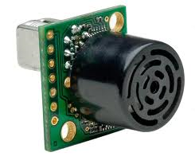
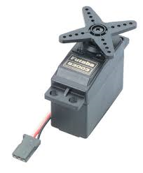

MSP430 Ports
MSP430 Ports
Computer communicates with external world thru 8 bit memory locations called Ports.
Each Port bit is independently programmable for Input or Output.
Edge-selectable input interrupt capability (P1/P2 only) and programmable pull-up/pull-down resistors available.
Port Registers
PxIN – read from port
PxOUT – write to port
PxDir – set port direction (input or output)

Slide 28
Quiz 3.2
1. What is an ISA?
2. What is a memory address space?
3. What is memory addressability?
4. What is a computer port?
5. List some distinctive properties of the MSP430 ISA.

Slide 29
Assembly Primer

Slide 30
MSP430 Assembler
Assembler Primer
A typical assembly language line has four parts:
label—starts in the column 1 and may be followed by a colon (:) for clarity.
operation—either an instruction, which is translated into binary machine code for the processor itself, or a directive, which controls the assembler.
operands—data needed for this operation (not always required).
comment—text following a semicolon (;).
start: | mov.w | #0x0280,sp | ; setup stack pointer
Label: | Operation | Operands | Comment

Slide 31
MSP430 Assembler
Assembler Primer
Labels are case sensitive, but instructions and directives are not - pick a style and stick with it.
Use comments freely in assembly language – otherwise your program is unreadable and very difficult to debug.
The default base (radix) of numbers in assembly language is decimal. The C-style notation 0xA5 for hexadecimal numbers is now widely accepted by assemblers. Other common notations include $A5, h'A5' and 0A5h. Binary numbers can similarly be written as 10100101b.
Use symbolic names for constants and expressions. The ".equ" and ".set" assembler directives provide macro text replacement for this purpose. (Make upper case.)

Slide 32
Assembler Coding Style
Assembler Primer
Instructions / DIRECTIVES start in column 12.
No line should exceed 80 characters.
Operands start in column 21.
Comments start in column 45.
Labels start in column 1 and are 10 characters or fewer.
;*************************************************************************
; CS/ECEn 124 Lab 1 - blinky.asm: Software Toggle P1.0
;
; Description: Toggle P1.0 by xor'ing P1.0 inside of a software loop.
;*************************************************************************
DELAY .equ 0
.cdecls C,"msp430.h" ; MSP430
.text ; beginning of executable code
reset: mov.w #0x0280,SP ; init stack pointer
mov.w #WDTPW+WDTHOLD,&WDTCTL ; stop WDT
bis.b #0x01,&P1DIR ; set P1.0 as output
mainloop: xor.b #0x01,&P1OUT ; toggle P1.0
mov.w #DELAY,r15 ; use R15 as delay counter
delayloop: sub.w #1,r15 ; delay over?
jnz delayloop ; n
jmp mainloop ; y, toggle led
.sect ".reset" ; MSP430 RESET Vector
.word reset ; start address
.end
Begin writing your assembly code after the ".text" directive.
The ".cdecls" directive inserts a header file into your program.
Use macros provided in the MSP430 header file.
Instructions are lower case and macros are UPPER CASE.
The ".end" directive is the last line of your program.
Assembler directives begin with a period (.)

Slide 33
MSP430 Instructions

Slide 34
MSP430 Instructions
Instruction Formats
The first 4-bits (nybble) of an instruction is called the opcode and specifies not only the instruction but also the instruction format.
The MSP430 ISA uses three formats to encode instructions for processing by the CPU core: double operand, single operand, and jumps.
Single and double operand instructions process word (16-bits) or byte (8-bit) data operations. (Default is word)
Complete orthogonal instruction set – Although the MSP430 architecture implements only 27 instructions, every instruction is usable with every addressing mode throughout the entire memory map.
High register count, page free, stack processing, memory to memory operations, constant generator.

Slide 35
MSP430 Instructions
MSP430 Instructions
1 cycle needed to
fetch instruction
Memory
0 | 1 | 0 | 0 | 0 | 1 | 0 | 1 | 0 | 0 | 0 | 0 | 0 | 1 | 0 | 0
0 | 0 | 0 | 1 | 0 | 0 | 0 | 0 | 0 | 0 | 0 | 0 | 0 | 1 | 0 | 1
0 | 0 | 1 | 0 | 1 | 1 | 1 | 1 | 1 | 1 | 1 | 0 | 0 | 1 | 0 | 0
0 | 1 | 0 | 0 | 0 | 0 | 0 | 0 | 0 | 0 | 1 | 1 | 0 | 0 | 0 | 1
0 | 0 | 0 | 0 | 0 | 1 | 1 | 0 | 0 | 0 | 0 | 0 | 0 | 0 | 0 | 0
R0
Program Counter
mov.w r5,r4
rrc.w r5
jc main
mov.w #0x0600,r1
Instruction Register
15 | 14 | 13 | 12 | 11 | 10 | 9 | 8 | 7 | 6 | 5 | 4 | 3 | 2 | 1 | 0
0 | 1 | 0 | 0 | 0 | 1 | 0 | 1 | 0 | 0 | 0 | 0 | 0 | 1 | 0 | 0
Opcode
0000
Opcode | Instruction | Format
0000 | Undefined | Single Operand
0001 | RCC, SWPB, RRA, SXT, PUSH, CALL, RETI
0010 | JNE, JEQ, JNC, JC | Jumps
0011 | JN, JGE, JL, JMP
0100 | MOV | Double Operand
0101 | ADD
0110 | ADDC
0111 | SUBC
1000 | SUB
1001 | CMP
1010 | DADD
1011 | BIT
1100 | BIC
1101 | BIS
1110 | XOR
1111 | AND
0001
0010
0011
0100
0101
0110
4 to 16 Decoder
0111
1000
1001
1010
1011
1100
1101
1110
1111

Slide 36
MPS430 Instruction Formats
MSP430 Instructions
Format I: Instructions with two operands:
15 | 14 | 13 | 12 | 11 | 10 | 9 | 8 | 7 | 6 | 5 | 4 | 3 | 2 | 1 | 0
Opcode |  |  |  | S-reg |  |  |  | Ad | b/w | As |  | D-reg
Format II: Instruction with one operand:
15 | 14 | 13 | 12 | 11 | 10 | 9 | 8 | 7 | 6 | 5 | 4 | 3 | 2 | 1 | 0
Opcode (4 + 5 bits) |  |  |  |  |  |  |  |  | b/w | As |  | D/S-reg
Format III: Jump instructions:
15 | 14 | 13 | 12 | 11 | 10 | 9 | 8 | 7 | 6 | 5 | 4 | 3 | 2 | 1 | 0
Opcode (4 + 2 bits) |  |  |  |  |  | 10-bit, 2’s complement PC offset

Slide 37
Format I: Double Operand
Double Operand Instructions
Double operand instructions:
Mnemonic | Operation | Description
Arithmetic instructions
ADD(.B or .W) src,dst | src+dst→dst | Add source to destination
ADDC(.B or .W) src,dst | src+dst+C→dst | Add source and carry to destination
DADD(.B or .W) src,dst | src+dst+C→dst (dec) | Decimal add source and carry to destination
SUB(.B or .W) src,dst | dst+.not.src+1→dst | Subtract source from destination
SUBC(.B or .W) src,dst | dst+.not.src+C→dst | Subtract source and not carry from destination
Logical and register control instructions
AND(.B or .W) src,dst | src.and.dst→dst | AND source with destination
BIC(.B or .W) src,dst | .not.src.and.dst→dst | Clear bits in destination
BIS(.B or .W) src,dst | src.or.dst→dst | Set bits in destination
BIT(.B or .W) src,dst | src.and.dst | Test bits in destination
XOR(.B or .W) src,dst | src.xor.dst→dst | XOR source with destination
Data instructions
CMP(.B or .W) src,dst | dst-src | Compare source to destination
MOV(.B or .W) src,dst | src→dst | Move source to destination

Slide 38
Example: Double Operand
Double Operand Instructions
Copy the contents of a register to another register
Assembly: mov.w r5,r4
Instruction code: 0x4504
One word instruction
The instruction instructs the CPU to copy the 16-bit 2’s complement number in register r5 to register r4
Opcode mov | S-reg r5 | Ad Register | b/w 16-bits | As Register | D-reg r4
0 1 0 0 | 0 1 0 1 | 0 | 0 | 0 0 | 0 1 0 0

Slide 39
Format II: Single Operand
Single Operand Instructions
Single operand instructions:
Mnemonic | Operation | Description
Logical and register control instructions
RRA(.B or .W) dst | MSB→MSB→… LSB→C | Roll destination right
RRC(.B or .W) dst | C→MSB→…LSB→C | Roll destination right through carry
SWPB( or .W) dst | Swap bytes | Swap bytes in destination
SXT dst | bit 7→bit 8…bit 15 | Sign extend destination
PUSH(.B or .W) src | SP-2→SP, src→@SP | Push source on stack
Program flow control instructions
CALL(.B or .W) dst | SP-2→SP, PC+2→@SP dst→PC |  | Subroutine call to destination
RETI | @SP+→SR, @SP+→SP |  | Return from interrupt

Slide 40
Example: Single Operand
Single Operand Instructions
Logically shift the contents of register r5 to the right through the status register carry
Assembly: rrc.w r5
Instruction code: 0x1005
One word instruction
The CPU shifts the 16-bit register r5 one bit to the right (divide by 2) – the carry bit prior to the instruction becomes the MSB of the result while the LSB shifted out replaces the carry bit in the status register
Opcode rrc | b/w 16-bits | As Register | D/S-reg r5
0 0 0 1 0 0 0 0 0 | 0 | 0 0 | 0 1 0 1

Slide 41
Jump Instruction Format
Jump Instructions
15 | 14 | 13 | 12 | 11 | 10 | 9 | 8 | 7 | 6 | 5 | 4 | 3 | 2 | 1 | 0
Opcode + Condition |  |  |  |  |  | 10-bit, 2’s complement PC offset
Jump instructions are used to direct program flow to another part of the program (by changing the PC).
The condition on which a jump occurs depends on the Condition field consisting of 3 bits:
000: jump if not equal
001: jump if equal
010: jump if carry flag equal to zero
011: jump if carry flag equal to one
100: jump if negative (N = 1)
101: jump if greater than or equal (N = V)
110: jump if lower (N ≠ V)
111: unconditional jump

Slide 42
Jump Instruction Format
Jump Instructions
Jump instructions are executed based on the current PC and the status register
Conditional jumps are controlled by the status bits
Status bits are not changed by a jump instruction
The jump off-set is represented by the 10-bit, 2’s complement value:
Thus, the range of the jump is -511 to +512 words, (-1023 to 1024 bytes ) from the current instruction
Note: Use a BR instruction to jump to any address

Slide 43
Example: Jump Format
Jump Instructions
Continue execution at the label main if the carry bit is set
Assembly: jc main
Instruction code: 0x2fe4
One word instruction
The CPU will add to the incremented PC (R0) the value -28 x 2 if the carry is set
Opcode JC | Condition Carry Set | 10-Bit, 2’s complement PC offset -28
0 0 1 | 0 1 1 | 1 1 1 1 1 0 0 1 0 0

Slide 44
Quiz 3.3
How are the sixteen MSP430 registers the same?
How do they differ?
What does 8-bit addressibility mean?
Why does the MSP430 have a 16-bit data bus?
What does the “addc.w r11,r12” instruction do?

Slide 45
MSP430 Addressing Modes

Slide 46
Addressing Modes
Addressing Modes
MSP430 has 4 basic ways to get an operand.
Address mode: Register + Mode (As or Ad)
Register
Memory
Register
+
Indexed Register
Index
Register Indirect
Indirect Auto-increment
← +1,2

Slide 47
Addressing Modes (C, C++)
Addressing Mode | Assembly | C, C++
Register | mov.w r4,r5 | int dog, cat; cat = dog;
Indexed Register | mov.b table(r4),r5 | char table[100]; cat = table[dog];
Indirect Register | mov.b @r6,r5 | char* cow = table; cat = *cow;
Indirect Auto-increment | mov.b @r6+,r5 | cat = *cow++;
Immediate | mov.w #100,r5 | cat = 100;
Absolute | mov.w &100,r5 | cat = *100;
Symbolic | mov.w dog,r5 | cat = dog;

Slide 48
Source Addressing Modes
Addressing Modes
The MSP430 has four basic addressing modes for the source address (As):
00 = Rs - Register (+0 cycles)
01 = index(Rs) - Indexed Register (+2 cycles)
10 = @Rs - Register Indirect (+1 cycle)
11 = @Rs+ - Indirect Auto-increment (+1 cycle)
When used in combination with registers R0-R3, three additional source addressing modes are available:
label - PC Relative, index(PC) (+2 cycles)
&label – Absolute, index(SR) (+2 cycles)
#n – Immediate, @PC+ (+1 cycle)
Constant generator with R2 and R3:
#-1, 0, 1, 2, 4, 8 (+1 cycle)
30% code savings

Slide 49
Destination Addressing Modes
Addressing Modes
There are only two basic addressing modes for the destination address (Ad):
0 = Rd - Register (+0 cycles)
1 = index(Rd) - Indexed Register (+2 cycles)
When used in combination with registers R0/R2, two additional destination addressing modes are available:
label - PC Relative, index(PC) (+2 cycles)
&label – Absolute, index(SR) (+2 cycles)
Storing result in memory adds an additional clock cycle.

Slide 50
Instruction Operand Access
Addressing Modes
1 ;****************************************************
2 .cdecls C,"msp430.h" ; MSP430
3 000 .text
4
5 8000 540A reset: add.w r4,r10 ; r10 = r4 + r10
6 8002 541A add.w 6(r4),r10 ; r10 = M(r4+6) + r10
8004 0006
7 8006 542A add.w @r4,r10 ; r10 = M(r4) + r10
8 8008 543A add.w @r4+,r10 ; r10 = M(r4++) + r10
9 800a 501A add.w cnt,r10 ; r10 = M(cnt) + r10
800c 0012
10 800e 521A add.w &cnt,r10 ; r10 = M(cnt) + r10
8010 801E
11 8012 503A add.w #100,r10 ; r10 = 100 + r10
8014 0064
12 8016 531A add.w #1,r10 ; r10 = 1 + r10
13 8018 5090 add.w cnt,var ; var = M(cnt) + M(var)
801a 0004
801c 0004
14
15 801e 0000 cnt: .word 0
16 8020 0000 var: .word 0
Register
Indexed Register
Indirect Register
Indirect Auto-inc
Symbolic or PC relative
Absolute
Immediate
Constant

Slide 51
00 = Register Mode
Addressing Modes
opcode |  |  |  | S-reg |  |  |  | Ad | b/w | As |  | D-reg
0 | 1 | 0 | 1 | 0 | 1 | 0 | 0 | 0 | 0 | 0 | 0 | 1 | 0 | 1 | 0
add.w r4,r10 ;r10 = r4 + r10
0x0000
Memory
Address Bus
CPU
Data Bus (1 cycle)
0x540a
IR
Registers
PC
0x540a
+2
PC
PC
R4
ADDER
R10
ALU
1 Cycle Instruction
0xFFFF

Slide 52
01 = Indexed Mode
Addressing Modes
opcode |  |  |  | S-reg |  |  |  | Ad | b/w | As |  | D-reg
0 | 1 | 0 | 1 | 0 | 1 | 0 | 0 | 0 | 0 | 0 | 1 | 1 | 0 | 1 | 0
0 | 0 | 0 | 0 | 0 | 0 | 0 | 0 | 0 | 0 | 0 | 0 | 0 | 1 | 1 | 0
add.w 6(r4),r10 ;r10 = M(r4+6) + r10
0x0000
Address Bus
Memory
CPU
Data Bus (1 cycle)
0x541a
IR
Registers
+2
PC
0x541a
+2
PC
PC
0x0006
Data Bus (+1 cycle)
PC
R4
Address Bus
ADDER
R10
Data Bus (+1 cycle)
ALU
3 Cycle Instruction
0xFFFF

Slide 53
10 = Indirect Register Mode
Addressing Modes
opcode |  |  |  | S-reg |  |  |  | Ad | b/w | As |  | D-reg
0 | 1 | 0 | 1 | 0 | 1 | 0 | 0 | 0 | 0 | 1 | 0 | 1 | 0 | 1 | 0
add.w @r4,r10 ;r10 = M(r4) + r10
0x0000
Memory
Address Bus
CPU
Data Bus (1 cycle)
0x542a
IR
Registers
PC
0x542a
+2
PC
PC
R4
Address Bus
ADDER
R10
Data Bus (+1 cycle)
ALU
2 Cycle Instruction
0xFFFF

Slide 54
Addressing Modes
11 = Indirect Auto-increment Mode
opcode |  |  |  | S-reg |  |  |  | Ad | b/w | As |  | D-reg
0 | 1 | 0 | 1 | 0 | 1 | 0 | 0 | 0 | 0 | 1 | 1 | 1 | 0 | 1 | 0
add.w @r4+,r10 ;r10 = M(r4+) + r10
0x0000
Memory
Address Bus
CPU
Data Bus (1 cycle)
0x543a
IR
Registers
PC
0x543a
+2
PC
PC
Address Bus
0002
R4
ADDER
R10
Data Bus (+1 cycle)
ALU
2 Cycle Instruction
0xFFFF

Slide 55
Addressing Mode Variations
Indexed Register
xxxx(PC) = Symbolic (PC Relative)
xxxx(SR) = Absolute (SR = R2 = 0)
Constants
@SR = 4
@SR+ = 8
R3 = 0
xxxx(R3 ) = 1
@R3 = 2
@R3+ = -1

Slide 56
Addressing Modes
01 w/R0 = Symbolic Mode (PC Relative)
opcode |  |  |  | S-reg |  |  |  | Ad | b/w | As |  | D-reg
0 | 1 | 0 | 1 | 0 | 0 | 0 | 0 | 0 | 0 | 0 | 1 | 1 | 0 | 1 | 0
0 | 0 | 0 | 0 | 0 | 0 | 0 | 0 | 0 | 0 | 0 | 0 | 1 | 1 | 0 | 0
add.w cnt,r10 ;r10 = M(cnt) + r10
0x0000
Address Bus
Memory
CPU
Data Bus (1 cycle)
0x501a
IR
Registers
+2
PC
0x501a
PC
+2
PC
PC
0x000c
PC
Data Bus (+1 cycle)
Address Bus
ADDER
cnt
R10
Data Bus (+1 cycle)
ALU
3 Cycle Instruction
0xFFFF

Slide 57
Addressing Modes
01 w/R2 = Absolute Mode
opcode |  |  |  | S-reg |  |  |  | Ad | b/w | As |  | D-reg
0 | 1 | 0 | 1 | 0 | 0 | 1 | 0 | 0 | 0 | 0 | 1 | 1 | 0 | 1 | 0
1 | 1 | 0 | 0 | 0 | 0 | 0 | 0 | 0 | 0 | 0 | 1 | 1 | 0 | 0 | 0
add.w &cnt,r10 ;r10 = M(cnt) + r10
0x0000
Address Bus
Memory
CPU
Data Bus (1 cycle)
0x521a
IR
Registers
+2
PC
0x521a
+2
PC
PC
0xc018
Data Bus (+1 cycle)
PC
0000
Address Bus
ADDER
cnt
R10
Data Bus (+1 cycle)
ALU
3 Cycle Instruction
0xFFFF

Slide 58
Addressing Modes
11 w/R0 = Immediate Mode
opcode |  |  |  | S-reg |  |  |  | Ad | b/w | As |  | D-reg
0 | 1 | 0 | 1 | 0 | 0 | 0 | 0 | 0 | 0 | 1 | 1 | 1 | 0 | 1 | 0
0 | 0 | 0 | 0 | 0 | 0 | 0 | 0 | 0 | 1 | 1 | 0 | 0 | 1 | 0 | 0
add.w #100,r10 ;r10 = 100 + r10
0x0000
Address Bus
Memory
CPU
Data Bus (1 cycle)
0x503a
IR
Registers
+2
PC
0x503a
+2
PC
PC
0x0064
PC
Data Bus (+1 cycle)
ADDER
R10
ALU
2 Cycle Instruction
0xFFFF

Slide 59
Addressing Modes
Constant Generator
opcode |  |  |  | S-reg |  |  |  | Ad | b/w | As |  | D-reg
0 | 1 | 0 | 1 | 0 | 0 | 1 | 1 | 0 | 0 | 0 | 1 | 1 | 0 | 1 | 0
add.w #1,r10 ;r10 = #1 + r10
0x0000
Memory
Address Bus
CPU
Data Bus (1 cycle)
0x531a
IR
Registers
PC
0x531a
+2
PC
0000
0001
0002
0004
0008
ffff
PC
ADDER
R10
ALU
1 Cycle Instruction
0xFFFF

Slide 60
Addressing Modes
Three Word Instruction
opcode |  |  |  | S-reg |  |  |  | Ad | b/w | As |  | D-reg
0 | 1 | 0 | 1 | 0 | 0 | 0 | 0 | 1 | 0 | 0 | 1 | 0 | 0 | 0 | 0
0 | 0 | 0 | 0 | 0 | 0 | 0 | 0 | 0 | 0 | 0 | 0 | 1 | 1 | 0 | 0
0 | 0 | 0 | 0 | 0 | 0 | 1 | 0 | 0 | 0 | 0 | 1 | 1 | 0 | 0 | 0
add.w cnt,var ;var = M(cnt) + M(var)
0x0000
Address Bus
Memory
CPU
Data Bus (1 cycle)
0x5090
IR
Registers
+2
+2
PC
0x5090
+2
PC
PC
PC
0x000c
Data Bus (+1 cycle)
PC
0x0218
PC
Data Bus (+1 cycle)
Address Bus
ADDER
cnt
Data Bus (+1 cycle)
Address Bus
var
ALU
Data Bus (+1 cycle)
Data Bus (+1 cycle)
6 Cycle Instruction
0xFFFF

Slide 61
Instruction Length and Cycles

Slide 62
Instruction Length
Instruction Length
1 word (2 bytes) for instruction:
Format I:
Format II:
Format III:
15 | 14 | 13 | 12 | 11 | 10 | 9 | 8 | 7 | 6 | 5 | 4 | 3 | 2 | 1 | 0
Opcode |  |  |  | S-reg |  |  |  | Ad | b/w | As |  | D-reg
15 | 14 | 13 | 12 | 11 | 10 | 9 | 8 | 7 | 6 | 5 | 4 | 3 | 2 | 1 | 0
Opcode |  |  |  |  |  |  |  |  | b/w | As |  | D/S-reg
15 | 14 | 13 | 12 | 11 | 10 | 9 | 8 | 7 | 6 | 5 | 4 | 3 | 2 | 1 | 0
Opcode |  |  |  |  |  | 10-bit, 2’s complement PC offset
1 additional word (2 bytes) for each of the following addressing modes:
Source index mode (As = 01)
mov 10(r4),r5
mov cnt,r5
mov &P1IN,r5
Source immediate mode (As = 11, S-reg = PC)
(except constants -1, 0, 1, 2, 4, 8 which use S-reg = r2/r3)
mov #100,r5
mov r4,10(r5)
mov r4,cnt
mov r4,&P1OUT
Destination index mode (Ad = 1)

Slide 63
Instruction Clock Cycles
MSP430 Clock Cycles
Generally, 1 cycle per memory access:
1 cycle to fetch instruction word
+1 cycle if source is @Rn, @Rn+, or #Imm
+2 cycles if source uses indexed mode
1st to fetch base address
2nd to fetch source
Includes absolute and symbolic modes
+2 cycles if destination uses indexed mode
+1 cycle if writing destination back to memory
Additionally
+1 cycle if writing to PC (R0)
Jump instructions are always 2 cycles

Slide 64
Quiz 3.4
What is the length (in words) and cycles for each of the following instructions?
Instruction | L | C |  | Instruction | L | C
add.w r5,r6 |  |  |  | mov.w EDE,TONI
add.w cnt(r5),r6 |  |  |  | mov.b &MEM,&TCDAT
add.w @r5,r6 |  |  |  | mov.w @r10,r11
add.w @r5+,r6 |  |  |  | mov.b @r10+,tab(r6)
add.w cnt,r6 |  |  |  | mov.w #45,TONI
add.w &cnt,r6 |  |  |  | mov.w #2,&MEM
add.w #100,r6 |  |  |  | mov.b #1,r11
mov.w r10,r11 |  |  |  | mov.w #45,r11
mov.w @r5,6(r6) |  |  |  | mov.b #-1,-1(r15)
mov.w 0(r5),6(r6) |  |  |  | mov.w @r10+,r10
1.
2.
3.
4.
5.
6.
7.
8.
9.
10.
11.
12.
13.
14.
15.
16.
17.
18.
19.
20.

Slide 65
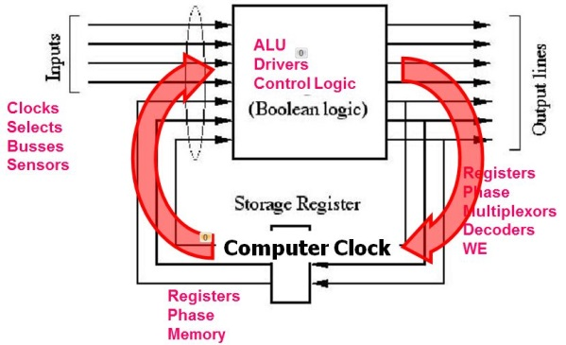
Processor Speed
Instruction Clock Cycles
MCLK – Master Clock
Most instruction phases require a clock cycle
No clock, no instruction execution
CPI – Cycles Per Instruction
Average number of clock cycles per complete instruction.
MIPS – Millions of Instructions per Second (MIPS)
Characterizes a processor’s performance
MIPS = MCLK / CPI.
Clock speed ≠ faster computer
MCLK = 2 MHz, CPI = 5, MIPS = 0.4
MCLK = 1 MHz, CPI = 2, MIPS = 0.5

Slide 66
Quiz 3.5
Given a 1.2 MHz processor, what value for DELAY would result in a ≈1/4 second delay?
?
DELAY .equ
mov.w #DELAY,r12 ; 2 cycles
delay1: mov.w #1000,r15 ; 2 cycles
delay2: sub.w #1,r15 ; 1 cycle
jne delay2 ; 2 cycles
sub.w #1,r12 ; 1 cycle
jne delay1 ; 2 cycles

Slide 67
Disassembling Instructions

Slide 68
How to Disassemble MSP430 Code
Instruction Disassembly
1. Begin with a “PC” pointing to the first word in program memory.
2. Retrieve instruction word and increment PC by 2.
R0
0100 0000 0011 0001
0xc000: 4031
0xc002: 0400
0xc004: 40b2
0xc006: 5a80
0xc008: 0120
0xc00a: 427f
0xc00c: 12b0
0xc00e: c012
0xc010: 3ffc
0xc012: 831f
0xc014: 23fe
0xc016: 4130
R0

Slide 69
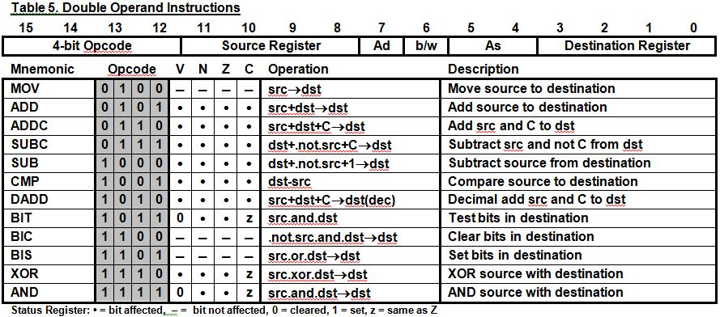
How to Disassemble MSP430 Code
Instruction Disassembly
3. List the instruction mnemonic using the opcode (bits 12-15).
4. Append “.b” or “.w” using the b/w bit when appropriate (0=w, 1=b).
0100 0000 0011 0001
0100 0000 0 0 11 0001
0100 0000 0011 0001
mov
.w
0xc000: 4031
0xc002: 0400
0xc004: 40b2
0xc006: 5a80
0xc008: 0120
0xc00a: 427f
0xc00c: 12b0
0xc00e: c012
0xc010: 3ffc
0xc012: 831f
0xc014: 23fe
0xc016: 4130
R0

Slide 70
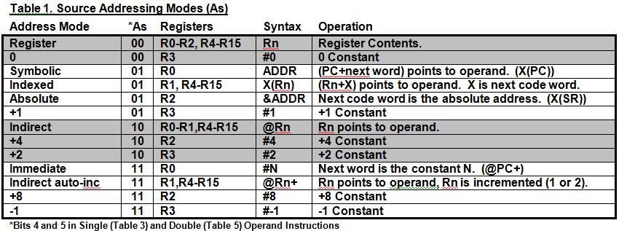
How to Disassemble MSP430 Code
Instruction Disassembly
5. If double operand instruction, decode and list source operand. (If
necessary, fetch operand from memory and increment PC by 2.)
0100 0000 0 0 11 0001
mov
.w
#
0x0400
0xc000: 4031
0xc002: 0400
0xc004: 40b2
0xc006: 5a80
0xc008: 0120
0xc00a: 427f
0xc00c: 12b0
0xc00e: c012
0xc010: 3ffc
0xc012: 831f
0xc014: 23fe
0xc016: 4130
R0
R0

Slide 71
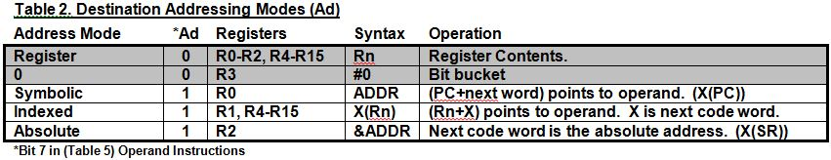
How to Disassemble MSP430 Code
Instruction Disassembly
6. If single or double operand instruction, decode and list destination
operand.
0100 0000 0 0 11 0001
mov
.w
#
0x0400
,r1
0xc000: 4031
0xc002: 0400
0xc004: 40b2
0xc006: 5a80
0xc008: 0120
0xc00a: 427f
0xc00c: 12b0
0xc00e: c012
0xc010: 3ffc
0xc012: 831f
0xc014: 23fe
0xc016: 4130
R0

Slide 72
How to Disassemble MSP430 Code
Instruction Disassembly
…Retrieve instruction word, increment PC by 2, list mnemonic, and operand size.
0100 0000 0011 0001
mov
.w
#
0x0400
,r1
0xc000: 4031
0xc002: 0400
0xc004: 40b2
0xc006: 5a80
0xc008: 0120
0xc00a: 427f
0xc00c: 12b0
0xc00e: c012
0xc010: 3ffc
0xc012: 831f
0xc014: 23fe
0xc016: 4130
0100 0000 1011 0010
R0
0100 0000 1 0 11 0010
mov
.w
R0

Slide 73
How to Disassemble MSP430 Code
Instruction Disassembly
…Retrieve immediate source operand and increment PC by 2.
0100 0000 0011 0001
mov
.w
#
0x0400
,r1
0xc000: 4031
0xc002: 0400
0xc004: 40b2
0xc006: 5a80
0xc008: 0120
0xc00a: 427f
0xc00c: 12b0
0xc00e: c012
0xc010: 3ffc
0xc012: 831f
0xc014: 23fe
0xc016: 4130
0100 0000 1 0 11 0010
mov
.w
#
0x5a80
R0
R0

Slide 74
How to Disassemble MSP430 Code
Instruction Disassembly
…Retrieve absolute destination operand and increment PC by 2.
0100 0000 0011 0001
mov
.w
#
0x0400
,r1
0xc000: 4031
0xc002: 0400
0xc004: 40b2
0xc006: 5a80
0xc008: 0120
0xc00a: 427f
0xc00c: 12b0
0xc00e: c012
0xc010: 3ffc
0xc012: 831f
0xc014: 23fe
0xc016: 4130
0100 0000 1 0 11 0010
mov
.w
#
0x5a80
,&
0x120
R0
R0

Slide 75
How to Disassemble MSP430 Code
Instruction Disassembly
…Retrieve instruction word, increment PC by 2, list mnemonic, and operand size.
0100 0000 0011 0001
mov
.w
#
0x0400
,r1
0xc000: 4031
0xc002: 0400
0xc004: 40b2
0xc006: 5a80
0xc008: 0120
0xc00a: 427f
0xc00c: 12b0
0xc00e: c012
0xc010: 3ffc
0xc012: 831f
0xc014: 23fe
0xc016: 4130
0100 0000 1011 0010
mov
.w
#
0x5a80
,&
0x120
0100 0010 0 1 11 1111
R0
0100 0010 0111 1111
mov
.b
R0

Slide 76

How to Disassemble MSP430 Code
Instruction Disassembly
…Use constant generator R2 for source operand.
0100 0000 0011 0001
mov
.w
#
0x0400
,r1
0xc000: 4031
0xc002: 0400
0xc004: 40b2
0xc006: 5a80
0xc008: 0120
0xc00a: 427f
0xc00c: 12b0
0xc00e: c012
0xc010: 3ffc
0xc012: 831f
0xc014: 23fe
0xc016: 4130
0100 0000 1011 0010
mov
.w
#
0x5a80
,&
0x120
0100 0010 0 1 11 1111
mov
.b
#8
R0

Slide 77
How to Disassemble MSP430 Code
Instruction Disassembly
…Use register mode for destination operand.
0100 0000 0011 0001
mov
.w
#
0x0400
,r1
0xc000: 4031
0xc002: 0400
0xc004: 40b2
0xc006: 5a80
0xc008: 0120
0xc00a: 427f
0xc00c: 12b0
0xc00e: c012
0xc010: 3ffc
0xc012: 831f
0xc014: 23fe
0xc016: 4130
0100 0000 1011 0010
mov
.w
#
0x5a80
,&
0x120
0100 0010 0 1 11 1111
mov
.b
#8
,r15
R0

Slide 78
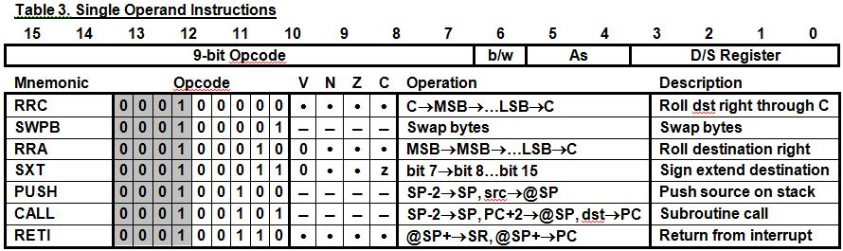
How to Disassemble MSP430 Code
Instruction Disassembly
…Retrieve instruction word, increment PC by 2, list mnemonic, (but no operand size is used.)
0100 0000 0011 0001
mov
.w
#
0x0400
,r1
0xc000: 4031
0xc002: 0400
0xc004: 40b2
0xc006: 5a80
0xc008: 0120
0xc00a: 427f
0xc00c: 12b0
0xc00e: c012
0xc010: 3ffc
0xc012: 831f
0xc014: 23fe
0xc016: 4130
0100 0000 1011 0010
mov
.w
#
0x5a80
,&
0x120
0100 0010 0111 1111
mov
.b
#8
,r15
0001 0010 1011 0000
R0
000100101 0 11 0000
call
.w
R0

Slide 79

How to Disassemble MSP430 Code
Instruction Disassembly
…Retrieve immediate destination operand from memory and increment PC by 2.
0100 0000 0011 0001
mov
.w
#
0x0400
,r1
0xc000: 4031
0xc002: 0400
0xc004: 40b2
0xc006: 5a80
0xc008: 0120
0xc00a: 427f
0xc00c: 12b0
0xc00e: c012
0xc010: 3ffc
0xc012: 831f
0xc014: 23fe
0xc016: 4130
0100 0000 1011 0010
mov
.w
#
0x5a80
,&
0x120
0100 0010 0111 1111
mov
.b
#8
,r15
000100101 0 11 0000
call
.w
#
0xc012
R0
R0

Slide 80
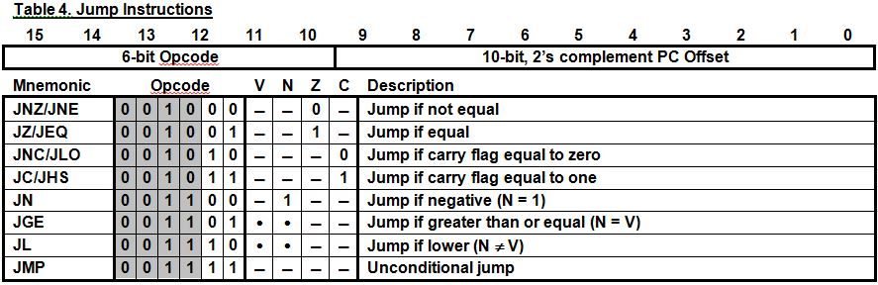
How to Disassemble MSP430 Code
Instruction Disassembly
…Retrieve instruction word, increment PC by 2, and list mnemonic.
0100 0000 0011 0001
mov
.w
#
0x0400
,r1
0xc000: 4031
0xc002: 0400
0xc004: 40b2
0xc006: 5a80
0xc008: 0120
0xc00a: 427f
0xc00c: 12b0
0xc00e: c012
0xc010: 3ffc
0xc012: 831f
0xc014: 23fe
0xc016: 4130
0100 0000 1011 0010
mov
.w
#
0x5a80
,&
0x120
0100 0010 0111 1111
mov
.b
#8
,r15
0001 0010 1011 0000
call
.w
#
0xc012
001111 1111111100
R0
0011 1111 1111 1100
jmp
R0

Slide 81
How to Disassemble MSP430 Code
Instruction Disassembly
…Calculate destination address by sign extending the least significant 10 bits, multiplying by 2, and adding the current PC.
0100 0000 0011 0001
mov
.w
#
0x0400
,r1
0xc000: 4031
0xc002: 0400
0xc004: 40b2
0xc006: 5a80
0xc008: 0120
0xc00a: 427f
0xc00c: 12b0
0xc00e: c012
0xc010: 3ffc
0xc012: 831f
0xc014: 23fe
0xc016: 4130
0100 0000 1011 0010
mov
.w
#
0x5a80
,&
0x120
0100 0010 0111 1111
mov
.b
#8
,r15
0001 0010 1011 0000
call
.w
#
0xc012
001111 1111111100
jmp
0xc00a
R0
(-4 × 2) + 0xc012 = 0xc00a

Slide 82
How to Disassemble MSP430 Code
Instruction Disassembly
…Retrieve instruction word, increment PC by 2, list mnemonic, and operand size.
0100 0000 0011 0001
mov
.w
#
0x0400
,r1
0xc000: 4031
0xc002: 0400
0xc004: 40b2
0xc006: 5a80
0xc008: 0120
0xc00a: 427f
0xc00c: 12b0
0xc00e: c012
0xc010: 3ffc
0xc012: 831f
0xc014: 23fe
0xc016: 4130
0100 0000 1011 0010
mov
.w
#
0x5a80
,&
0x120
0100 0010 0111 1111
mov
.b
#8
,r15
0001 0010 1011 0000
call
.w
#
0xc012
0011 1111 1111 1100
jmp
0xc00a
1000 0011 0 0 01 1111
R0
1000 0011 0001 1111
sub
.w
R0

Slide 83
How to Disassemble MSP430 Code
Instruction Disassembly
…Use constant generator R3 for immediate source operand.
0100 0000 0011 0001
mov
.w
#
0x0400
,r1
0xc000: 4031
0xc002: 0400
0xc004: 40b2
0xc006: 5a80
0xc008: 0120
0xc00a: 427f
0xc00c: 12b0
0xc00e: c012
0xc010: 3ffc
0xc012: 831f
0xc014: 23fe
0xc016: 4130
0100 0000 1011 0010
mov
.w
#
0x5a80
,&
0x120
0100 0010 0111 1111
mov
.b
#8
,r15
0001 0010 1011 0000
call
.w
#
0xc012
0011 1111 1111 1100
jmp
0xc00a
1000 0011 0 0 01 1111
1000 0011 0001 1111
sub
.w
#1
R0

Slide 84
How to Disassemble MSP430 Code
Instruction Disassembly
…Use register mode for destination operand.
0100 0000 0011 0001
mov
.w
#
0x0400
,r1
0xc000: 4031
0xc002: 0400
0xc004: 40b2
0xc006: 5a80
0xc008: 0120
0xc00a: 427f
0xc00c: 12b0
0xc00e: c012
0xc010: 3ffc
0xc012: 831f
0xc014: 23fe
0xc016: 4130
0100 0000 1011 0010
mov
.w
#
0x5a80
,&
0x120
0100 0010 0111 1111
mov
.b
#8
,r15
0001 0010 1011 0000
call
.w
#
0xc012
0011 1111 1111 1100
jmp
0xc00a
1000 0011 0 0 01 1111
1000 0011 0001 1111
sub
.w
#1
,r15
R0

Slide 85
How to Disassemble MSP430 Code
Instruction Disassembly
…Retrieve instruction word, increment PC by 2, and list mnemonic.
0100 0000 0011 0001
mov
.w
#
0x0400
,r1
0xc000: 4031
0xc002: 0400
0xc004: 40b2
0xc006: 5a80
0xc008: 0120
0xc00a: 427f
0xc00c: 12b0
0xc00e: c012
0xc010: 3ffc
0xc012: 831f
0xc014: 23fe
0xc016: 4130
0100 0000 1011 0010
mov
.w
#
0x5a80
,&
0x120
0100 0010 0111 1111
mov
.b
#8
,r15
0001 0010 1011 0000
call
.w
#
0xc012
0011 1111 1111 1100
jmp
0xc00a
1000 0011 0001 1111
sub
.w
#1
,r15
0010 0011 1111 1110
R0
001000 1111111110
jne
R0

Slide 86
How to Disassemble MSP430 Code
Instruction Disassembly
…Calculate destination address by sign extending the least significant 10 bits, multiplying by 2, and adding the current PC.
0100 0000 0011 0001
mov
.w
#
0x0400
,r1
0xc000: 4031
0xc002: 0400
0xc004: 40b2
0xc006: 5a80
0xc008: 0120
0xc00a: 427f
0xc00c: 12b0
0xc00e: c012
0xc010: 3ffc
0xc012: 831f
0xc014: 23fe
0xc016: 4130
0100 0000 1011 0010
mov
.w
#
0x5a80
,&
0x120
0100 0010 0111 1111
mov
.b
#8
,r15
0001 0010 1011 0000
call
.w
#
0xc012
0011 1111 1111 1100
jmp
0xc00a
1000 0011 0001 1111
sub
.w
#1
,r15
001000 1111111110
jne
0xc012
R0
(-2 × 2) + 0xc016 = 0xc012

Slide 87
How to Disassemble MSP430 Code
Instruction Disassembly
…Retrieve instruction word, increment PC by 2, and list mnemonic.
0100 0000 0011 0001
mov
.w
#
0x0400
,r1
0xc000: 4031
0xc002: 0400
0xc004: 40b2
0xc006: 5a80
0xc008: 0120
0xc00a: 427f
0xc00c: 12b0
0xc00e: c012
0xc010: 3ffc
0xc012: 831f
0xc014: 23fe
0xc016: 4130
0100 0000 1011 0010
mov
.w
#
0x5a80
,&
0x120
0100 0010 0111 1111
mov
.b
#8
,r15
0001 0010 1011 0000
call
.w
#
0xc012
0011 1111 1111 1100
jmp
0xc00a
1000 0011 0001 1111
sub
.w
#1
,r15
0010 0011 1111 1110
jne
0xc012
0100 0001 0011 0000
R0
0100 0001 0 0 11 0000
mov
.w
R0

Slide 88
How to Disassemble MSP430 Code
Instruction Disassembly
…Use indirect register auto-increment mode for source operand.
0100 0000 0011 0001
mov
.w
#
0x0400
,r1
0xc000: 4031
0xc002: 0400
0xc004: 40b2
0xc006: 5a80
0xc008: 0120
0xc00a: 427f
0xc00c: 12b0
0xc00e: c012
0xc010: 3ffc
0xc012: 831f
0xc014: 23fe
0xc016: 4130
0100 0000 1011 0010
mov
.w
#
0x5a80
,&
0x120
0100 0010 0111 1111
mov
.b
#8
,r15
0001 0010 1011 0000
call
.w
#
0xc012
0011 1111 1111 1100
jmp
0xc00a
1000 0011 0001 1111
sub
.w
#1
,r15
0010 0011 1111 1110
jne
0xc012
0100 0001 0011 0000
0100 0001 0 0 11 0000
mov
.w
@r1+
R0

Slide 89
How to Disassemble MSP430 Code
Instruction Disassembly
…Use register mode for destination operand. (Pop the stack into the PC – “ret” instruction.)
0100 0000 0011 0001
mov
.w
#
0x0400
,r1
0xc000: 4031
0xc002: 0400
0xc004: 40b2
0xc006: 5a80
0xc008: 0120
0xc00a: 427f
0xc00c: 12b0
0xc00e: c012
0xc010: 3ffc
0xc012: 831f
0xc014: 23fe
0xc016: 4130
0100 0000 1011 0010
mov
.w
#
0x5a80
,&
0x120
0100 0010 0111 1111
mov
.b
#8
,r15
0001 0010 1011 0000
call
.w
#
0xc012
0011 1111 1111 1100
jmp
0xc00a
1000 0011 0001 1111
sub
.w
#1
,r15
0010 0011 1111 1110
jne
0xc012
0100 0001 0011 0000
0100 0001 0 0 11 0000
mov
.w
@r1+
,r0
R0

Slide 90
How to Disassemble MSP430 Code
Instruction Disassembly
…Continue the disassembly process.
0100 0000 0011 0001
mov
.w
#
0x0400
,r1
0xc000: 4031
0xc002: 0400
0xc004: 40b2
0xc006: 5a80
0xc008: 0120
0xc00a: 427f
0xc00c: 12b0
0xc00e: c012
0xc010: 3ffc
0xc012: 831f
0xc014: 23fe
0xc016: 4130
0100 0000 1011 0010
mov
.w
#
0x5a80
,&
0x120
0100 0010 0111 1111
mov
.b
#8
,r15
0001 0010 1011 0000
call
.w
#
0xc012
0011 1111 1111 1100
jmp
0xc00a
1000 0011 0001 1111
sub
.w
#1
,r15
0010 0011 1111 1110
jne
0xc012
0100 0001 0011 0000
mov
.w
@r1+
,r0
(ret)
R0

Slide 91
How to Disassemble MSP430 Code
Review
Begin with a “PC” pointing to the first word in program memory.
Retrieve instruction word and increment PC by 2.
Find and list the corresponding instruction mnemonic using the opcode (most significant 4-9 bits).
Append “.b” or “.w” using the b/w bit (0=word, 1=byte).
If double operand instruction, decode and list source operand (Table 5).
If single or double operand instruction, decode and list destination operand (Tables 3 and 5).
If jump instruction, sign extend the 10-bit PC offset, multiply by 2, and add to the current PC. List that address.

Slide 92
Quiz 3.6
Disassemble the following MSP430 instructions:
Address Data
0x8010: 4031
0x8012: 0600
0x8014: 40B2
0x8016: 5A1E
0x8018: 0120
0x801a: 430E
0x801c: 535E
0x801e: F07E
0x8020: 000F
0x8022: 1230
0x8024: 000E
0x8026: 8391
0x8028: 0000
0x802a: 23FD
0x802c: 413F
0x802e: 3FF6

Slide 93


